Slide 1

OS Lab 4- Shell Scripting
Instructor
Saba Naseem
Saba.naseem@nu.edu.pk

Slide 2
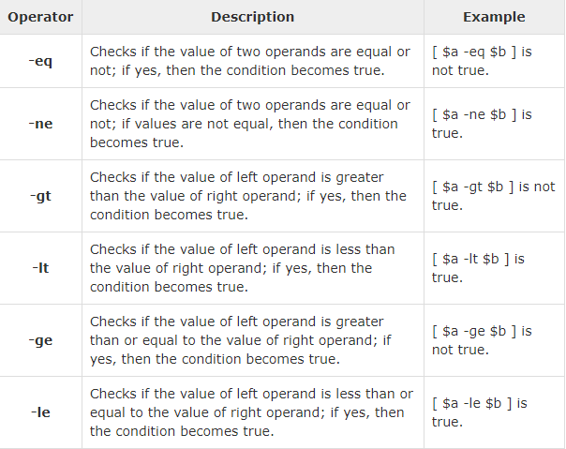
Mathematical Operation

Slide 3

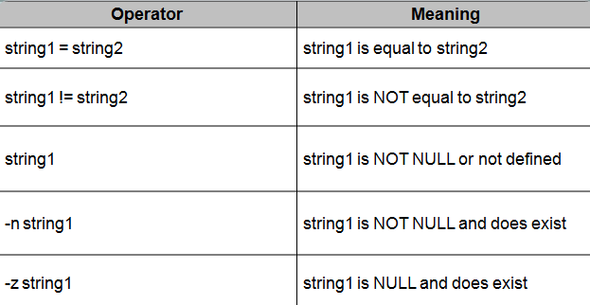
String Comparisons

Slide 4

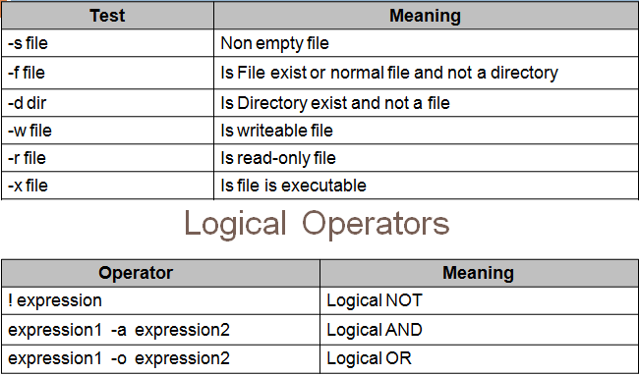
Tests for file and directory types:

Slide 5
Conditional Statements
IF statement:
if condition
then
then command1 if condition is true or if exit status of condition is 0 (zero)
fi

Slide 6
Conditional Statements
IF_ELSE condition
if condition then
condition is zero (true - 0) execute all commands up to else
else
if condition is not true then execute all commands up to fi
fi

Slide 7
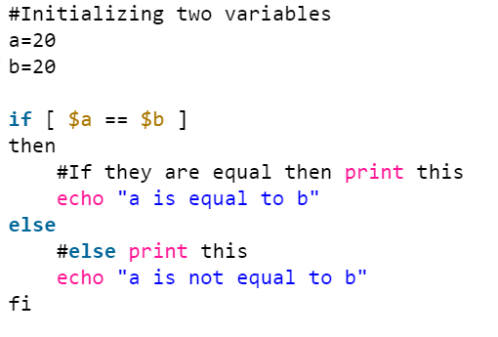

Slide 8
Conditional Statements
IF-Elif Statement:
if condition
then
………………
elif condition
then
………………
else
………………
fi

Slide 9
Case Statements
case $variable-name in
[pattern1] ) command
... .. command;;
[Pattern2] ) command
... .. command;;
[pattern] ) command
... .. command;;
*) command
... .. command;;
esac

Slide 10
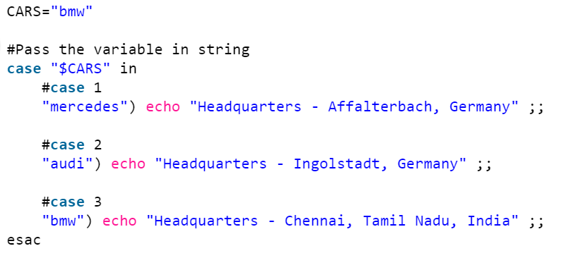

Slide 11
Functions
To declare function, simply use the following syntax:
Function_name() {}
Example:
#!/bin/sh
# Define your function here
Hello ()
{
echo "Hello World"
}
# Invoke your function
Hello

Slide 12
Built-in Functions
Built-in functions
Built- in functions are the function already defined in a programming language
the program does not require defining it
they directly use it with in their code
Some built-in functions are also defined in shell scripting e.g. random function etc.
Example:
num_rows=4
for ((i=1;i<=num_rows;i++))
do
echo $RANDOM
done

Slide 13
Built-in Functions
Built-in functions
Shift - shift [n] (Shift the positional parameters to the left by n)
Test- test expr ( evaluate a conditional expression and return status of 0/1)
Times- times (print out the user and system times used by the shell and its child process)

Slide 14
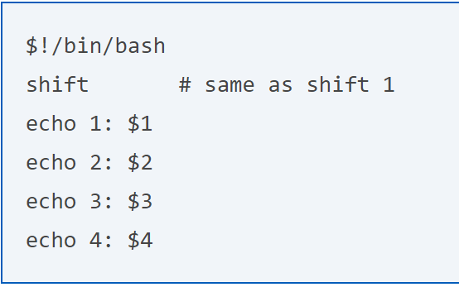
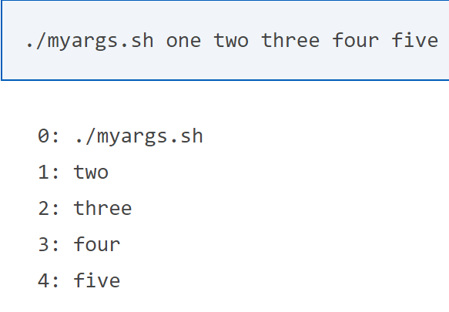
Notes:
The special positional parameter $0 is excluded from all shift operations, and never modified by the shift command.

Slide 15
Passing Parameters
Passing parameters
If you want to pass some values to the function like in other programming languages. You can do that using functions in Shell scripting
Example:
Func() {
Num=$1
#$1 is parameter value
echo $Num
}
Func 3 #function call , 3 is a parameter

Slide 16
Function returning value
Like other programming languages you can also return a value by a function
Note: Shell scripts can only return a single value.
Example
Func() {
Num=$1 #$1 is parameter value
echo $Num
return $Num
}
$num=$((Func 3)) #function call
echo “The sum is:” $num

Slide 17
Recursive functions
A recursive function is a function that calls itself during its execution.
This enables the function to repeat itself several times
outputting the result at the end of each iteration

Slide 18
Recursive functions
You can write a recursive function in shell script
Example
array=(1 2 3 4)
#l=3
f() {
if [ "$1 == -1 ]
then
return
else
a=$1
echo $((array[$a]))
f $((a-1)) #recursive function call
fi }
F 1 #function call with parameter

Slide 19
Arrays (1D & 2D)
A shell variable is capable enough to hold a single value.
These types of variables are called scalar variables.
Shell supports a different type of variable called an array variable that can hold multiple values at the same time.
Arrays provide a method of grouping a set of variables.
Instead of creating a new name for each variable that is required
you can use a single array variable that stores all the other variables.
Note: All the naming rules discussed for Shell Variables would be applicable while naming arrays.

Slide 20
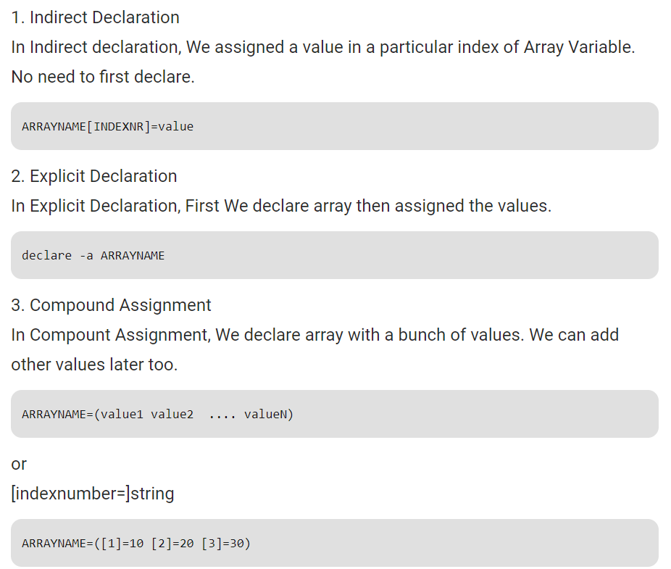

Slide 21
Arrays (1D & 2D)
If you are using the bash shell, here is the syntax of array initialization −
array_name[$index]=value;
Accessing Arrays:
After you have set any array variable, you access it as follows −
${array_name[index]}
You can access all the items in an array in one of the following ways:
${array_name[*]}
${array_name[@]}

Slide 22
1D Array Example
#---------Array Declaration---------#
NAME[0]="Zara“
NAME[1]="Qadir"
NAME[2]="Mahnaz"
NAME[3]="Ayan“
NAME[4]="Daisy"
echo "First Index: ${NAME[0]}"
echo "Second Index: ${NAME[1]}"
for i in “${NAME[@]}”
do
echo $(( array[$i]))
done

Slide 23
2D Array Example
You can also create a 2D array in shell script
Example
num_rows=4
num_columns=5
for ((i=1;i<=num_rows;i++)) do
for ((j=1;j<=num_columns;j++)) do
matrix[$i,$j]=$i
done
done

Slide 24
Arithmetic Operations
Bourne shell didn't originally have any mechanism to perform simple arithmetic operations but it uses external programs, either awk or expr.
The following example shows how to add two numbers −
#!/bin/sh
Val=‘expr 2+2’
Echo $val
The following points need to be considered while adding −
There must be spaces between operators and expressions. For example, 2+2 is not correct; it should be written as 2 + 2.
The complete expression should be enclosed between ‘ ‘.

Slide 25
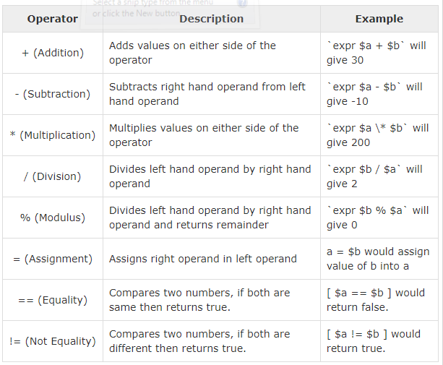

Slide 26
https://www.computerhope.com/unix/bash/shift.htm
https://www.computerhope.com/unix/test.htm
https://stackoverflow.com/questions/12314451/accessing-bash-command-line-args-vs/12316565
https://www.geeksforgeeks.org/array-basics-shell-scripting-set-1/
https://devhints.io/bash
End

